Slide 1

COMPANIES AND GEOPOLICAL RISKS Session 2
2025-2026
OMRI Yassine

Slide 2
I- Types of geopolitical Risk 1- Interstates wars : (US/ IRAQ. Dow corning)

Slide 3
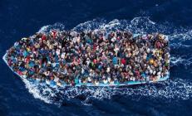
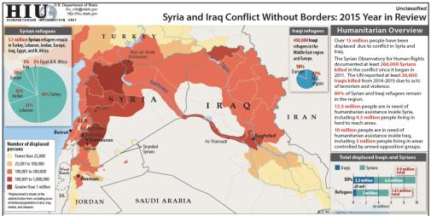
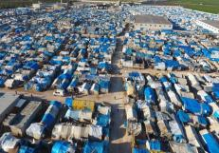
2. International conflict (Refugies)
Source : RFI

Slide 4
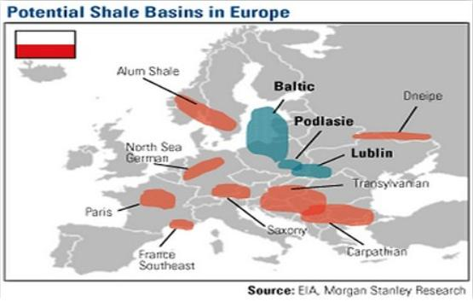
3. Law, regulations, policies : (San leon energy in POLAND)

Slide 5
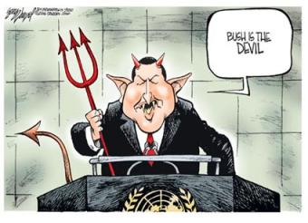
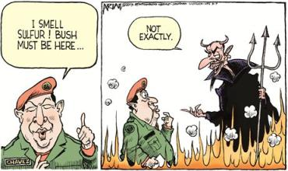
4. Breaches of contract : (Chavez : Venezuela)

Slide 6
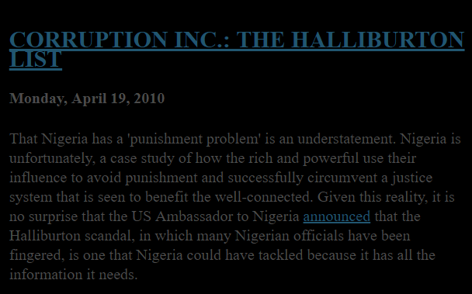
5. Corruption: Halliburton
Source : http://www.nigeriancuriosity.com/2010/04/corruption-inc-halliburton-list.html

Slide 7

6. Extraterritorial reach : total in Iran
https://www.youtube.com/results?search_query=corruption+total+iran

Slide 8

7. Natural ressources manipulation : (OPEC)
https://youtu.be/yCYRJBbLwQc?t=80
https://youtu.be/yCYRJBbLwQc?t=80

Slide 9


8. Social activism : (Nestle) /Orang Utan Monkey
https://www.youtube.com/watch?v=1BCA8dQfGi0

Slide 10
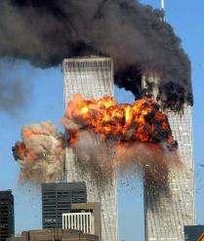

9. Terrorism : (Cantor fitzgerald)
https://www.youtube.com/watch?v=h3shmfKOZ9g
https://www.youtube.com/watch?v=pYWdUfxW10s

Slide 11
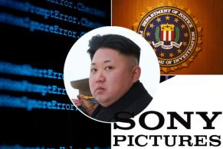
10. Cyber threats : (SONY)
https://www.youtube.com/watch?v=70KybrkiJp4

Slide 12
II. Measuring political risk

Slide 13
A) GEOPOLITICAL RISKS INDEX
GPR index is constructed with algorithm that counts the frequency of articles related to geopolitical risks leading international newpapers published in the USA, United Kingdom and Canada.
The newpapers (11) witch include :
The New York Times
Times
Washington Post
…

Slide 14
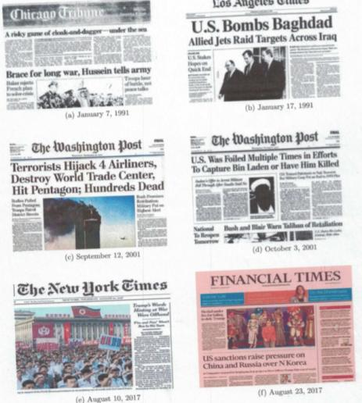

Slide 15
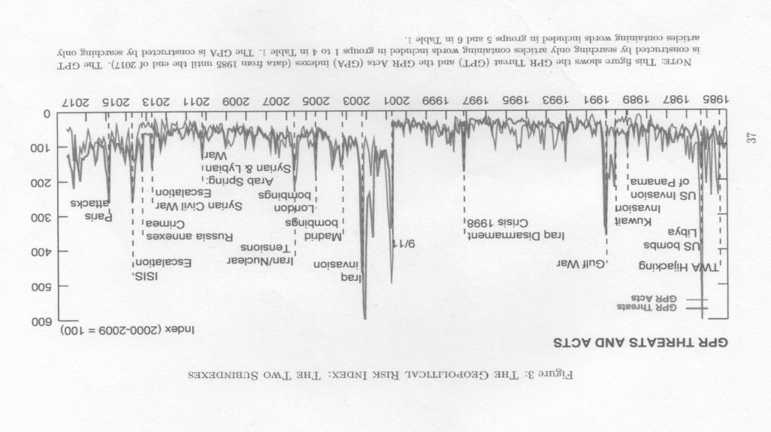

Slide 16
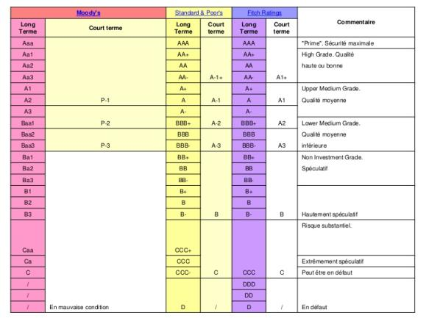
B) RATING AGENCIES
There are three main rating agencies: Moody's, Standard & Poor's and Fitch Rating. All three have different criteria for assessing countries.

Slide 17
III. Anticipating and Assuming

Slide 18
III. Anticipating and Assuming
We define anticipating and assuming by four steps :
Understand
Analyse
Mitigate
Respond

Slide 19
III. Anticipating and Assuming
Understand | Analyse | Mitigate | Respond
1. What is my organization’s political risk appetite ? | 1. How can we get good information about political risks we face ? | 1. How can we reduce exposure to the risks we have identified ? | 1. Are we capitalizing on near misses ?
2. Is there a shared understanding of our risk appetite ? If not, how can we foster one ? | 2. How can we ensure rigorous analysis ? | 2. Do we have a good system in place for timely warning and action ? | 2. Are we reacting effectively to crises ?
1. How can we reduce blind spots ? | 3. How can we integrate political risk analysis into business decisions ? | 3. How we can limit the damage when something bad happens ? | 3. Are we developing mechanisms for continuous learning ?

